Slide 1
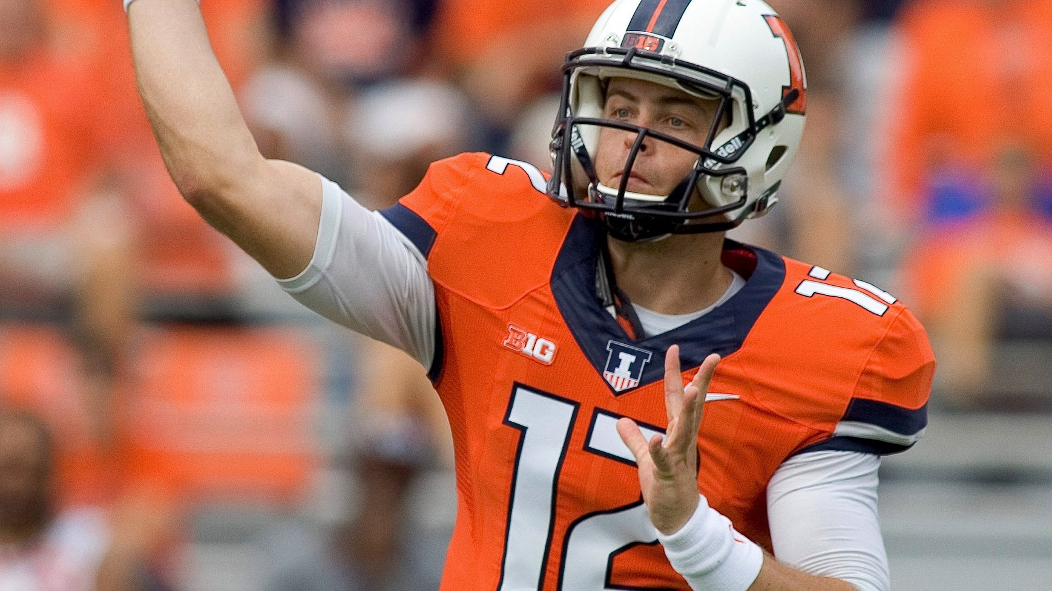

A Bayesian Approach to Predicting NFL Quarterback Scores in Fanduel Tournaments
Aaron Ray (aaronwr2)
Michael Chan (mhchan3)
Kiomars Nassiri (nassiri2)
STAT 578 - ABM

Slide 2
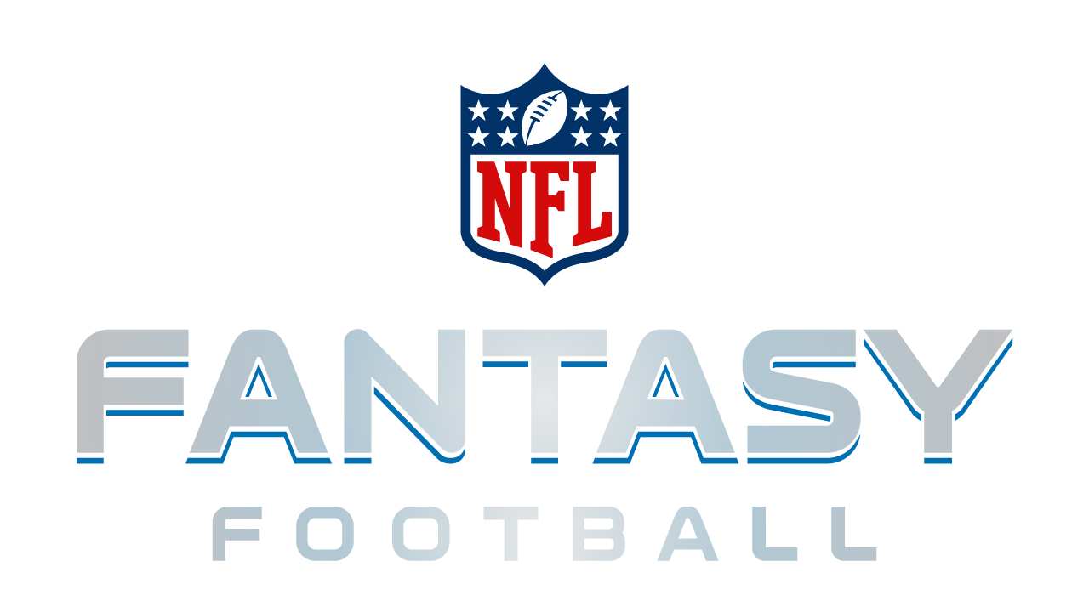
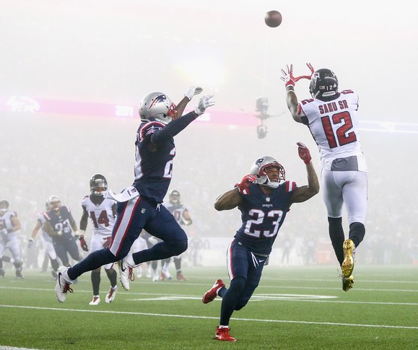
Fantasy Football
Participants in a Fantasy Football game act as the managers of a virtual football team and try to maximize their points by picking up the best line-up.
Points are given based on actual performance of players in real-world competition.
Each team is allowed a pre-determined number of players on its roster, as well as a specified number at each position that can or must be used in each game (the "starters")

Slide 3
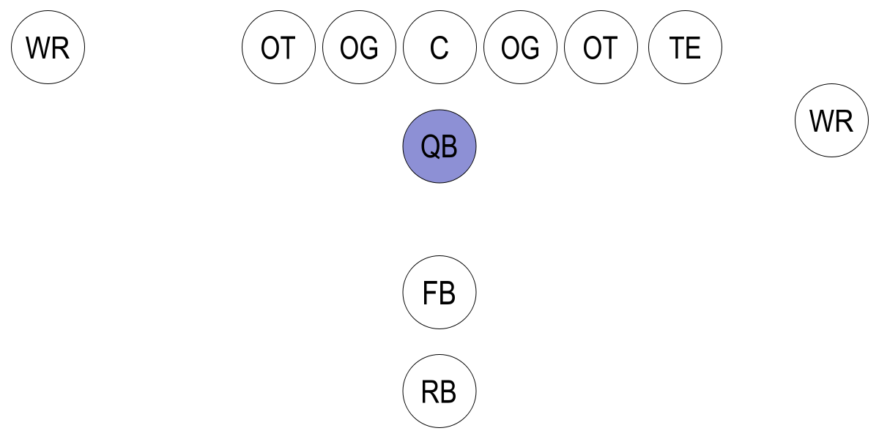
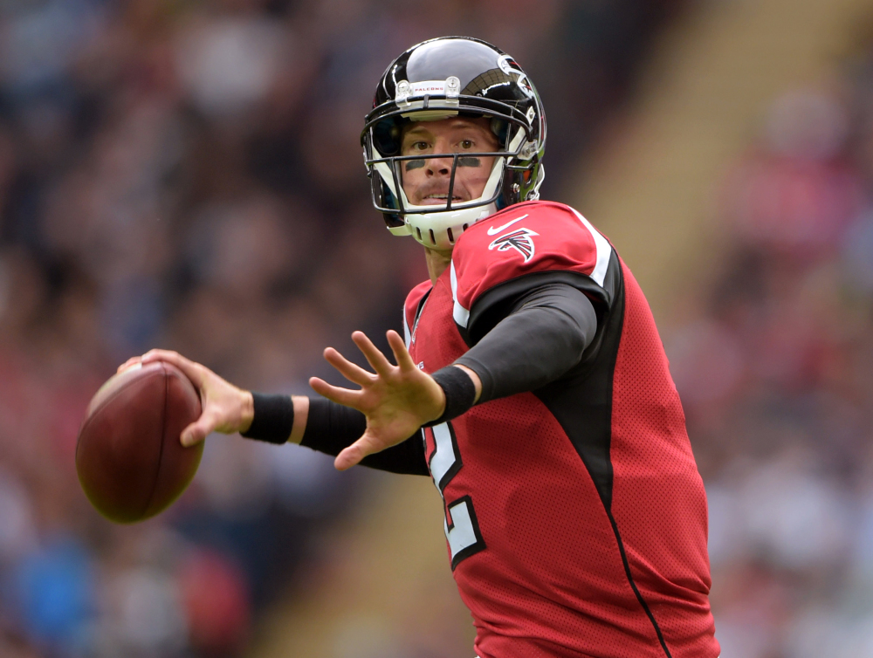
Quarterback (QB)
In this project, we are creating our Bayesian Model for the Quarterback position players.
Quarterbacks are usually considered the leader of the offensive team and they line up directly behind the offensive line.
“The quarterback touches the ball on almost every offensive play, and his successes and failures can have a significant impact on the fortunes of his team.” – Wikipedia

Slide 4

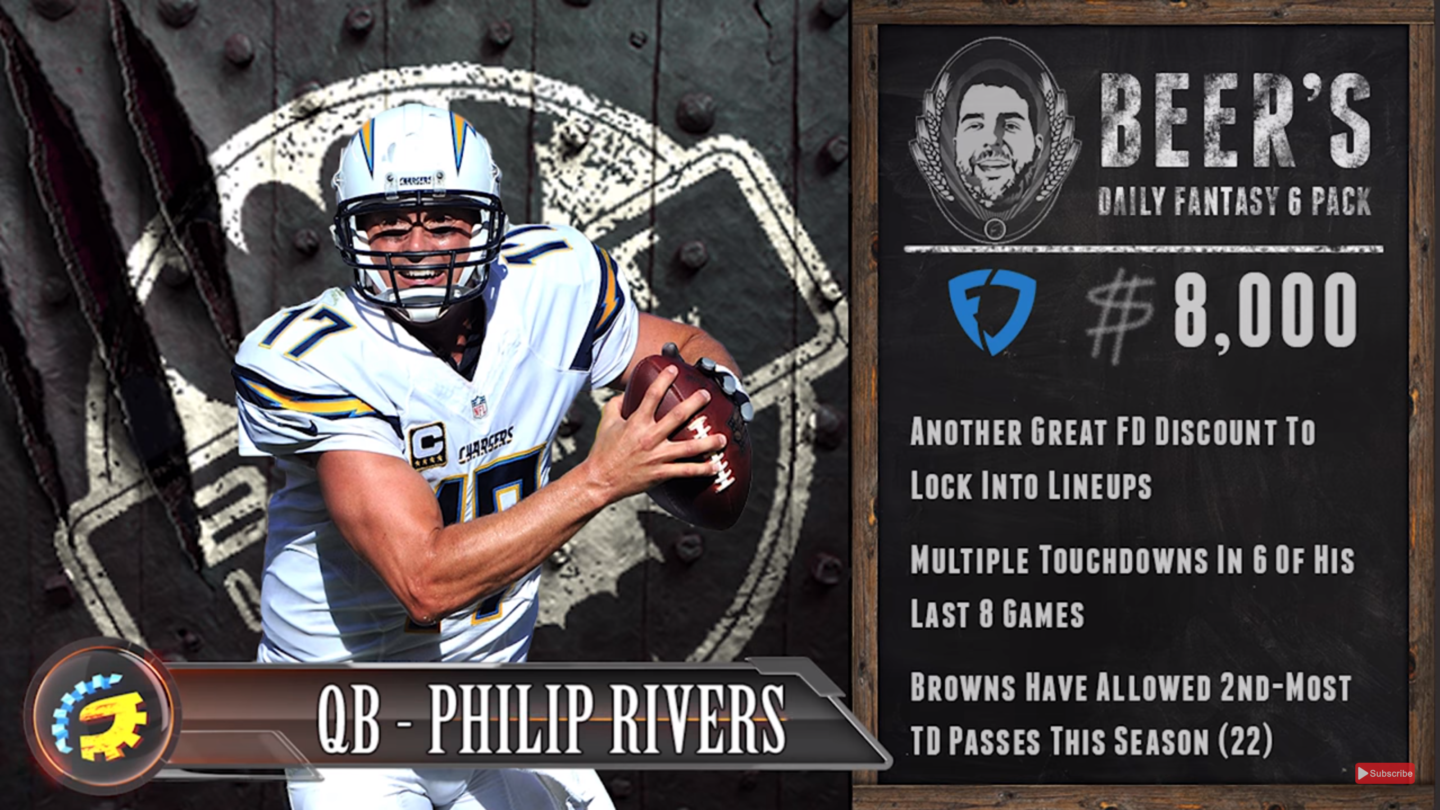
FanDuel
For the purpose of this project we have chosen to work with the data gathered from the FanDuel internet company.
“FanDuel is a web-based fantasy sports game and with 6 million registered users and is the second largest daily fantasy sports company (as measured by entry fees and user base) in the daily fantasy sports industry” – Wikipedia

Slide 5
Objective
We have leveraged a Hierarchical Bayesian approach with the Markov Chain Monte Carlo method to predict the fantasy points likely to be scored by an NFL quarterback in any given game.
The goal is to predict the points scored by each player given certain prior conditions and predictor variables that will assist our model in providing credible posterior prediction intervals.

Slide 6

Player Performance Data
Historical data on the performance of the players is extracted from the RotoGuru website.

